Slide 1


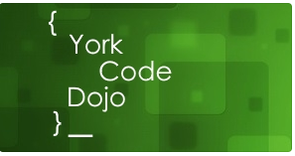
Mob Programming - Language Head to Head
David Betteridge
@da_betteridge

Slide 2
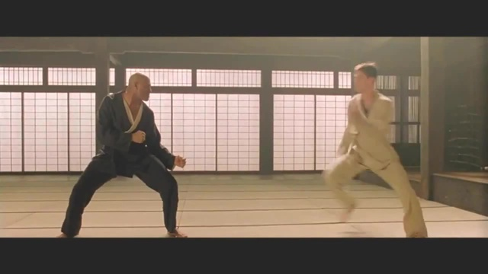
What is a Code Dojo
Notes:
Who has been to a code dojo before?
What is the point?
It’s a place to practice coding safely. By that we mean it doesn’t matter if you haven’t solved the problem by the end of the evening. No one will judge you on it. It’s a place to practice, learn and try out new things.
For example you could use a language you have never used before, partner with someone new, try a different approach to solving the problem. You could add your own constraints; like my functions won’t have more than three lines; or I’m not going to use any IF statements.
(It’s also meant to be fun) It’s driving a car to work every day, you might cover a lot of miles, but if you are doing the same journey then does your driving ability really improve?
It’s driving a car to work every day, you might cover a lot of miles, but if you are doing the same journey then does your driving ability really improve?

Slide 3
Tonight
Explain the problem
Work in two teams using Mob programming
Opportunity to show off solutions

Slide 4
Mob Programming
One Driver
Navigators
Swap Often

Slide 5
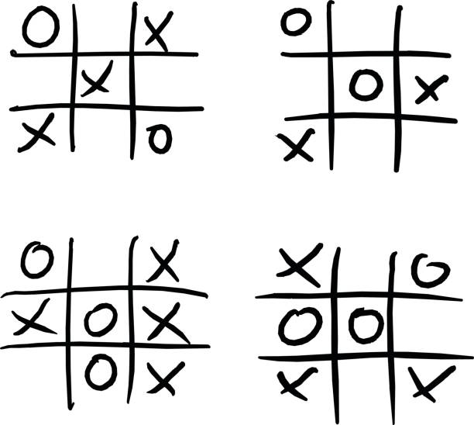
The Problem
Notes:
Given a board, is it
A win for Xs
A win for 0s
A draw
In progress

Slide 7
Next Meetings
Tomorrow! - 6:30pm @ York St. Johns - Sudoku
Dec – Advent of code problems
Jan – Job interview questions
Meetup - YorkCodeDojo
Slack - YorkDevelopers

